Slide 1

50.039 Theory and Practice of Deep Learning Course Introduction
Matthieu De Mari

Slide 2

A quick word about instructors
Matthieu (Matt) De Mari
Senior Lecturer at SUTD (Python, Deep Learning, Prog. Language Concepts, Capstone, etc.)
Director of the Master of Science in Design and Artificial Intelligence for Enterprise (MSc DAI-E)
PhD from CentraleSupelec (France)
Email: matthieu_demari@sutd.edu.sg
Office @ SUTD: 2.401-07 (located in SUTD Academy/AI cluster).

Slide 3
A quick word about instructors
Dileepa Fernando
Lecturer at SUTD (Python, Software Engineering, Programming Language Concepts and more)
Computer Science and Design (CSD)
PhD from NUS
Email: dileepa_fernando@sutd.edu.sg
Office @ SUTD: 1.402.24

Slide 4
A quick word about instructors
Li Kunrong (TA)
PhD student under the ISTD pillar.
Research interests include distributed systems, recommender systems, and LLM, with a focus on applying these techniques in real-world production environments.
Email: kunrong_li@mymail.sutd.edu.sg
Although currently overseas, our TA will be helping with designing and grading homeworks through the term. You may approach her via email in case of questions about homeworks.

Slide 5
Objectives of 50.039 DL
Introduce the technical aspects related to the implementation of Deep Neural Networks from scratch.
Teach the students about the most popular framework for implementing Deep Neural Networks (as of Jan 2026): PyTorch.
Discuss the mathematical foundations and intuitions behind Deep Learning tools, layers and techniques.
Give the students a global overview of the foundational and advanced techniques related to Deep Learning and Neural Networks.
Describe examples of practical applications of Deep Learning, showing how some key AI tools are implemented.

Slide 6
Objectives of 50.039 DL
Eventually, assemble all concepts and tricks of the trade discussed in this course to produce big architecture models that are close to the current state-of-the-art ones (e.g. ChatGPT, Dall-E, etc.).
Discuss ethical aspects related to some of the concepts discussed.
Give students an understanding of the current state of research in the Deep Learning community, and more specifically pointers on how to stay up-to-date in this fast-evolving field.
This includes tracking big names in the field, identifying key scientific papers that have changed the field, but also newsletters, websites or magazines that disclose information in Layman terms.

Slide 7
Skills needed for this course
Must-have CS: Python (loops and OOP!), Numpy, Matplotlib.
Must-have Math: Linear Algebra, Multiple Variables Calculus, Differentiation/Derivatives, Optimization, Probability and Statistics.
Good-to-have CS: ML, Data Processing, Pandas, Scipy, Sklearn.
Good-to-have Math: Graph Theory, Game theory.
Need to revise? No homeworks for the first couple of weeks…!
Use this time to revise your 10.014 CTD, 10.013 M&A, 10.018 MS&S, 10.022 MU, 10.020 DDW, and 50.007 ML! (Look at bonus slides for details on what to revise…)

Slide 8
The way we teach things
An expert is not someone who
Took a 6h-long online video course,
Implements Neural Networks by randomly connecting basic layers (typically Linear and Conv),
Uses a DL framework they do not understand (or worse, autoML!),
Cannot obtain more than 95% accuracy on a simple dataset like MNIST or CIFAR-10.
An expert is someone who
Understands how Neural Networks operate and the mathematical intuition behind typical/advanced operations used in layers,
Understands how the frameworks have been built and what they do behind the scenes,
Understands that AI is a fast-evolving field and knows how to stay up to date when it comes to AI.

Slide 9
The way we teach things
One topic per week (or so) and hopefully, we will cover all the important concepts and important directions of DL these days.
Lectures slides, along with supporting notebooks.
Mathematical aspects discussed in class (to show what is happening behind the scenes of Neural Networks/Deep Learning code).
Made a choice: providing lots of code to demonstrate concepts but need you to play with them autonomously!
Extra reading, for curiosity (supporting papers, articles, etc.) and suggestions of pointers to stay up-to-date.
Suggestions for continuing your learning, after this course.

Slide 10
The way we teach things
Every week, I will upload materials on both eDimension
eDimension lecture materials: Read-only, reference slides, and supporting Jupyter notebooks.
Video recaps (from previous years, being revised as time allows).
Note: The videos can be used for revision and self-study, but they clearly do not mean you should not come to class! Attendance will be a key component for the participation score.

Slide 11
Syllabus (Detailed syllabus on eDimension)
Week 1: Introduction to course and some ML reminders, including linear and polynomial regression, generalization, ridge regression and regularization, overfitting/underfitting, logistic regression, neurons objects and how they relate to biology. Building our first shallow neural network in Numpy, with gradient descent, training and testing.
Week 2: Introduction to PyTorch framework, tensors and dataloaders. Implementing a shallow neural network in PyTorch, using backpropagation in PyTorch with AutoGrad, advanced optimizers. Multi-label classification with shallow neural networks, moving from shallow to deep neural networks.

Slide 12
Syllabus
Week 3: Guided project and good practices for Deep Learning projects (train/test/dev, bias/variance, advanced regularization, dropout, normalizing inputs/outputs/layers, trainer functions, savers/loader functions for reproducibility and transfer learning). Discussion about the project assessment component.
Week 4: The image data type, image processing techniques and typical computer vision operations, the convolution operation and layers, Convolutional Neural Networks, advanced CNNs, foundational vision models and transfer learning. Preparing transition to the 50.035 Computer Vision course.

Slide 13
Syllabus
Week 5: Continuation of Week 4, and more advanced concepts of Computer Vision. Adversarial machine learning, attacking a Neural Network with basic gradient-based attacks, fundamental limits of Neural Networks, defence mechanisms and state-of-the-art of some advanced attacks techniques.
Week 6: Introduction to sequential data (numerical series, times series, etc.), vanilla Recurrent Neural Networks, Gated Recurrent Units, Long-Short Term Memory cells, advanced RNN networks, mixing models for advanced architectures. Recap before MidTerm.

Slide 14
Syllabus
Week 8: The embedding problem, more advanced concepts on RNNs, introduction to Natural Language Processing (NLP) and Word Embeddings for NLP, brief state-of-the-art on NLP, attention and transformers architectures. Preparing transition to the 50.040 Natural Language Processing course. MidTerm exam (based on W1-6). One lecture might move to Week 6 to make space for MidTerm exam.
Week 9: Introduction to Vision Transformers and how it relates to concepts in W4 and W8. Quick introduction to Graph Theory, typical graph datasets and problems, basics of Graph Convolutional Networks, brief state-of-the-art of advanced GCNs.

Slide 15
Syllabus
Week 10: Generative Models, Autoencoders and Variational Autoencoders, Generative Adversarial Networks (GANs), Advanced concepts on Generative Adversarial Networks, why is it so difficult to train GANs in practice. If time allows, practice on GANs.
Week 11: Brief introduction to reinforcement learning, and state-action-rewards systems, multi-armed bandit problem and the exploration/exploitation trade-off, Q-learning and Deep Q-Learning. Reinforcement Learning with Human Feedback. Brief state-of-the-art discussion about further works in Reinforcement Learning.

Slide 16
Syllabus
Week 12: Topics for curiosity. Introduction to Physics-Informed Neural Networks. Basic introduction to deep belief and diffusion models (more details to be covered in the 50.035 Computer Vision course). Introduction to Explainability/Interpretability, ethical questions on Deep Learning and open questions in research about Neural Networks.
Week 13: A word about ChatGPT, from a Deep Learning expert point of view. Closing and future directions for studying Deep Learning. Project presentations and possibly some guest conferences (TBA).
Week 14: Final exam (probably on content from W1-12).

Slide 17
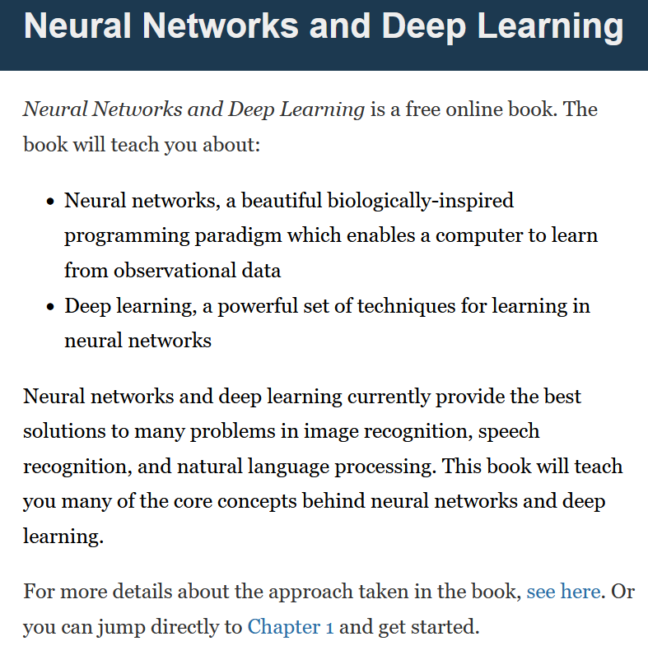
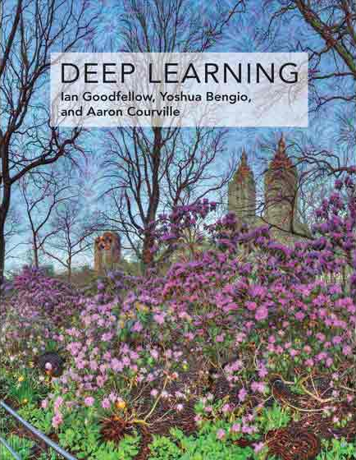

Supporting Textbooks
Supporting textbooks, for your curiosity (not needed to understand this course, just for reference).
Michael A. Nielsen, “Neural networks and deep learning”, 2015. (http://neuralnetworksanddeeplearning.com/)
Ian Goodfellow, Yoshua Bengio and Aaron Courville, “Deep learning”, 2016. (https://www.deeplearningbook.org/)
Stevens et al., “Deep Learning with PyTorch”, 2020. (https://www.manning.com/books/deep-learning-with-pytorch)

Slide 18
Evaluation and grading
Homeworks (15%): Given on Weeks 3, 5, 8, 10 (tentative) Usually come in the form of a Jupyter Notebook, containing explanations, code snippets and questions. Submissions on eDimension, two weeks later or so, as a small PDF report containing code, figures and answers to questions. When time allows, debrief of homeworks in class.
MidTerm Exam (25%): Usually given on Week 6, to be confirmed. Theoretical, paper exam, notions of Week 1-6 to be tested. More details about venue and exam to be announced closer to the exam date.

Slide 19
Evaluation and grading
Final Exam (25%): Given on Week 14, date to be confirmed. Theoretical, paper exam, notions of Week 1-13 to be tested. More details about venue and exam to be announced.
Project (28%): Groups of 2-3 students. Submission for project (code, report, presentation) expected on Week 13. More details about the project will be given on Week 3.
Participation (5%): To our discretion.
Student Feedback Survey (2%): As per usual.

Slide 20



Technical pre-requisites
Install Python 3, if you have not done so already (this course does not use the C++/Java version of PyTorch).
Libraries needed: numpy, matplotlib, scipy, sklearn, networkx, pillow, gym, torch, torchvision, torchmetrics, etc.
Jupyter notebooks for demos of code, along with the slides.
In doubt, you can always use Google Colab to run the codes.

Slide 21

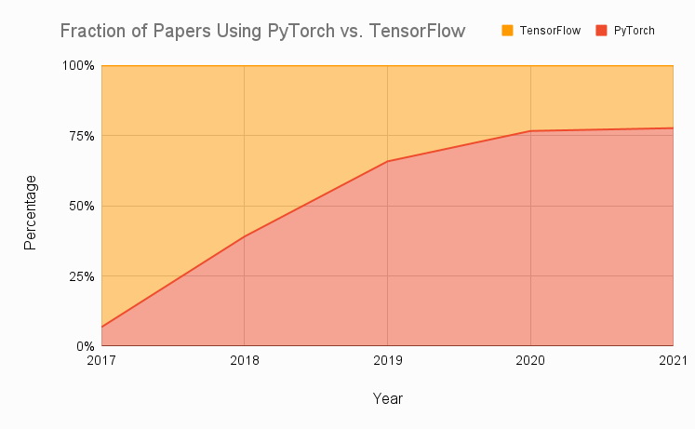
Technical pre-requisites
Framework of choice will be PyTorch! (not Tensorflow, not Keras, not MXNet, etc.)
Increasing popularity and preferred to Google’s Tensorflow these days for many reasons.
Learn more, if curious: https://www.assemblyai.com/blog/pytorch-vs-tensorflow-in-2022/
Also, this: https://arxiv.org/abs/2508.04035

Slide 22
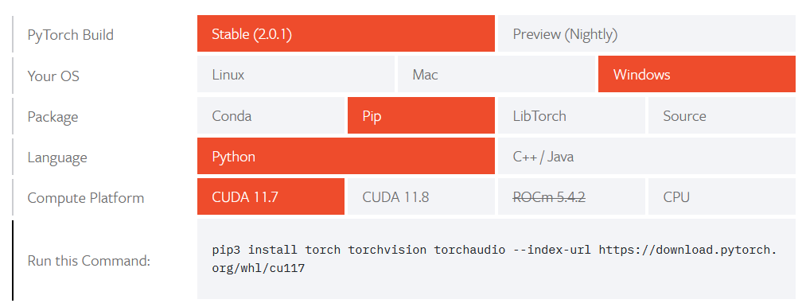
Installing PyTorch and CUDA
Install PyTorch, by getting the latest version (not the one shown below!) from https://pytorch.org/get-started/locally/
Setting up CUDA/GPU acceleration is always a good idea! (More details in bonus slides).

Slide 23
50.039 Theory and Practice of Deep Learning W1-S1 Introduction and Machine Learning Reminders
Matthieu De Mari

Slide 24
About this week (Week 1)
What are the typical concepts of Machine Learning to be used as a starting point for this course?
What are the different families of problems in Deep Learning?
What is the typical structure of a Deep Learning problem?
What is linear regression and how to implement it?
What is the gradient descent algorithm and how is it used to train Machine Learning models?
What is polynomial regression and how to implement it?
What is regularization and how to implement it in Ridge regression?

Slide 25
About this week (Week 1)
What is overfitting and why is it bad?
What is underfitting and why is it bad?
What is generalization and how to evaluate it?
What is a train-test split and why is it related to generalization?
What is a sigmoid function? What is a logistic function?
How to perform binary classification using a logistic regressor and how is it related to linear regression?

Slide 26
About this week (Week 1)
What are Neural Networks and how do they relate to the biology of a human brain?
What is a Neuron in a Neural Network and how does it relate to linear/logistic regression?
What is the difference between a shallow and a deep neural network?
How to implement a shallow Neural Network manually and define a forward propagation method for it?
How to train a shallow Neural Network using backpropagation? How to define backward propagation and trainer functions?

Slide 27
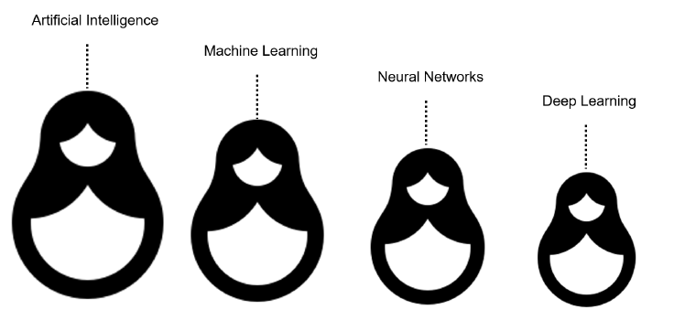
What is AI/ML/NN/DL?
Artificial intelligence
Machine Learning
Neural Networks
Deep Learning
Definition (Artificial Intelligence):
In Computer Science, Artificial Intelligence (AI) refers to the theory and development of computer systems capable to replicate/emulate the human brain, more specifically perform cognitive tasks that normally require human intelligence, such as visual perception, speech recognition, decision-making, and translation between languages.

Slide 28
What is AI/ML/NN/DL?
Conventional programming
Definition (Machine Learning):
In Computer Science, Machine Learning (ML) refers to the field of study that describes techniques and algorithms that give computers the ability to learn without being explicitly programmed.
Some implementations of machine learning may rely on data and neural networks.
Input (Given)
Function
(Created)
Output
(Obtained)
VS.
Machine Learning
Input (Available)
Function
(?)
Output
(Available)

Slide 29
What is AI/ML/NN/DL?
What we have done in programming so far was to design functions,
which would do specific operations,
and return outputs,
for any input we could give it.
But sometimes, we can encounter problems where
we can easily find inputs and expected outputs,
but the function to be coded is not simple to figure out.
E.g., what animal in picture?
Input (Given)
Function
(Created)
Output
(Obtained)
Input (Available)
Function
(?)
Output
(Available)

Slide 30

What is AI/ML/NN/DL?
E.g., what animal is in the picture?
Typical problem in Computer Vision, called Image Recognition.
Input x (available)
Function f
(?)
Output y = f(x)
(available)
Very easy for a human…
But, how would we explain the logic of it to a computer?
It’s a cat!

Slide 31
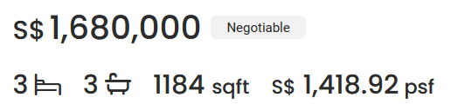
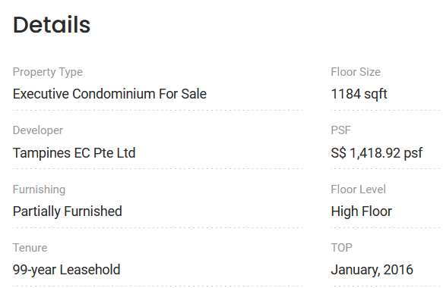

What is AI/ML/NN/DL?
Other scenarios have to do with tasks where there is no easy closed-form expression connecting inputs to outputs.
E.g., what is a good selling price for my appartment?
How would you guess the selling price of an appartment based on its parameters (size, location, etc.) and previous sales?

Slide 32
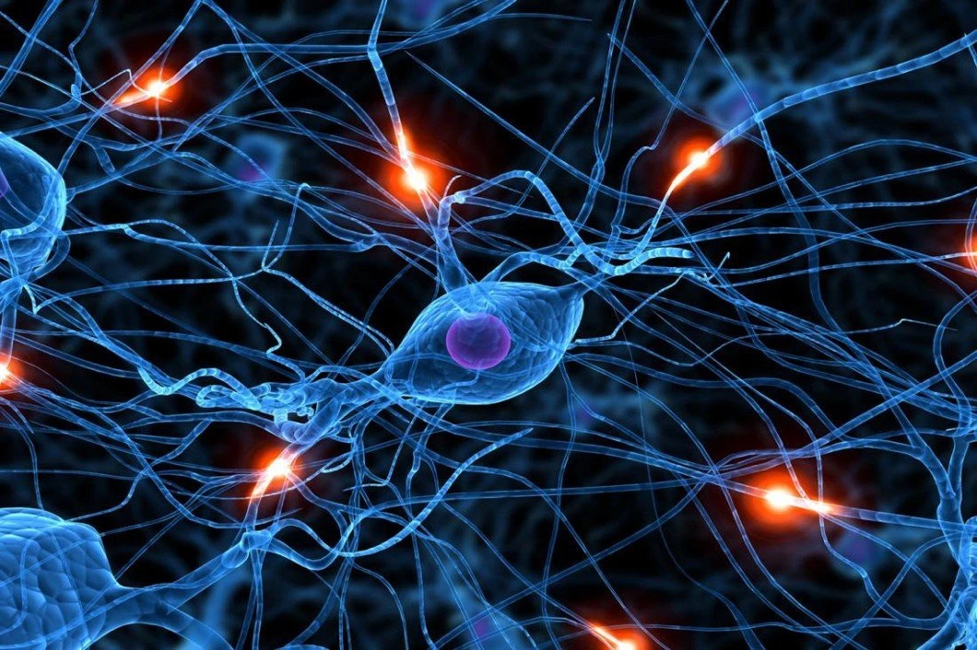
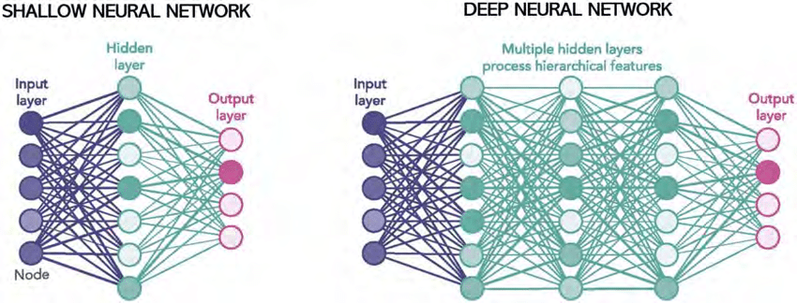
What is AI/ML/NN/DL?
Definition (Neural Networks):
Neural Networks (NNs) are computing systems inspired by the biological neural networks that constitute animal brains.
NNs are based on a collection of connected units (or nodes) called artificial neurons, which are a (loose) model for the neurons in a biological brain.

Slide 33
What is AI/ML/NN/DL?
Definition (Neural Networks):
Neural Networks (NNs) are computing systems inspired by the biological neural networks that constitute animal brains.
NNs are based on a collection of connected units (or nodes) called artificial neurons, which are a (loose) model for the neurons in a biological brain.
Each connection, like the synapses in a biological brain, can transmit a signal to other neurons, therefore processing any information given as inputs and producing a final signal as output.

Slide 34
What is AI/ML/NN/DL?
Definition (Deep Learning):
Deep Learning (DL) is a subfield of machine learning, and deep neural networks make up the backbone of deep learning algorithms.
The number of node layers, or depth, of neural networks is what distinguishes a shallow neural network from a deep neural network, which must have more than three.

Slide 35
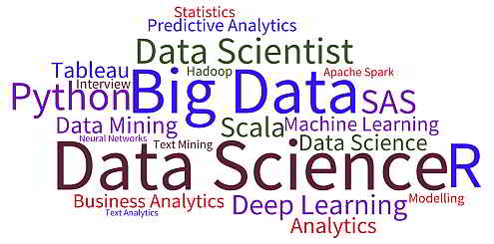
What is AI/ML/NN/DL?
Artificial intelligence
Machine Learning
Neural Networks
Deep Learning

Slide 36
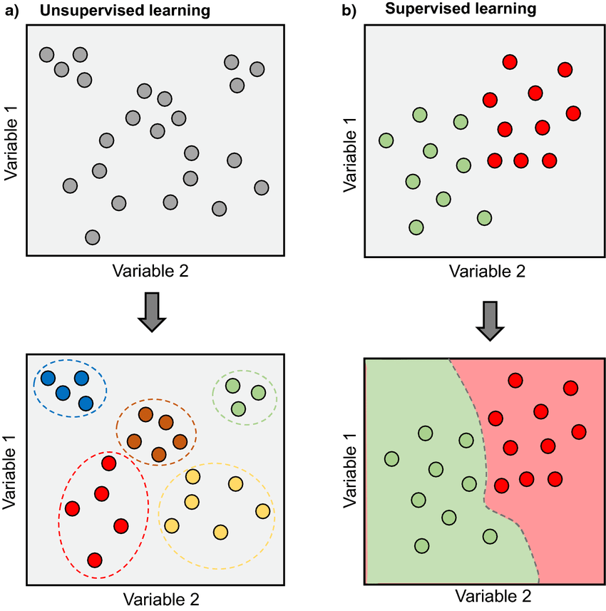
Supervised vs Unsupervised Learning
Definition (Supervised vs. Unsupervised Learning):
Supervised and Unsupervised Learning are the two techniques of ML.
The main difference is the need for labelled training data:
Supervised machine learning relies on labelled input and output data to learn and make predictions,
while unsupervised machine learning does not require labelled data.

Slide 37
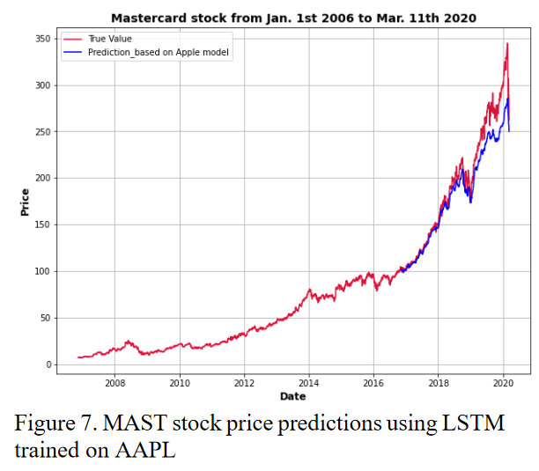
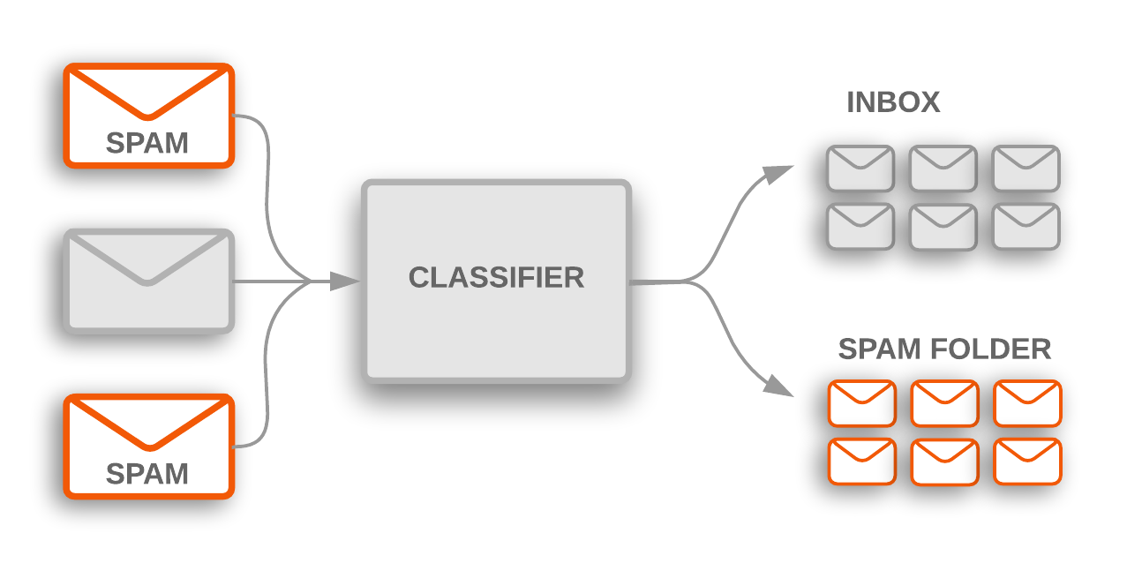
Supervised Learning Examples
Examples of supervised learning: spam detection, text classification, predicting the stock market, etc.

Slide 38
Regression vs. Classification (Supervised)
Definition (Classification):
Classification models are used to divide the samples in the dataset into different classes.
Classification algorithms are then used to predict/classify discrete or finite number values, such as Male or Female, True or False, Spam or Not Spam, etc.
In Classification, the outputs are discrete or categorical values.

Slide 39
Regression vs. Classification
Definition (Regression):
Regression models are used to identify the relationships between the input and output variables.
Regression algorithms are used to predict continuous values such as price, salary, age, etc.
In regression, the outputs are often continuous numerical values.

Slide 40
Supervised Learning Examples
Example: predicting the market.
Question: is it a regression or a classification task?

Slide 41
Supervised Learning Examples
Example: predicting the market.
Question: is it a regression or a classification task?
Depends.
If the output we are predicting is the value of the stock in the future, then probably regression.
If the plan is to predict whether we should buy, sell or hold, then probably classification.

Slide 42
Deep Learning and Supervised/Unsupervised
While it is possible to use Deep Learning models and Neural Networks to perform both Supervised and Unsupervised tasks…
The vast majority of DL/NN tasks fall in the category of supervised learning.
(And we will therefore mostly focus on that)

Slide 43
Elements of an ML problem
Definition (Elements of a ML problem):
Machine learning problems should be well-defined, i.e. the following elements must be clearly identified:
Task (T) at hand,
Inputs (I) and Outputs (O),
Model (M) definition and its trainable parameters (P),
Loss (L) function to measure the performance of current model on said task and dataset.

Slide 44
Our first toy example
Our first toy example: simplified version of the apartment price prediction.
Task (T) at hand:
Predict price of an apartment based on the apartment features.
We will generate a “fake” dataset consisting of apartments with features and selling prices.
It is a supervised regression task.

Slide 45
Our first toy example
Our first toy example: simplified version of the apartment price prediction.
Inputs (I) and Outputs (O):
Inputs will be a list of apartment features, which here will only consist of the surface of the apartment, in square meters (sqm).
Output will be the selling price in millions of SGD (mSGD).

Slide 46
Our first toy example (mock dataset)
Have a look at Week 1, Notebook 1.
We will create a dataset, which uses surfaces as inputs, with values drawn randomly between 40 and 150 sqm.
We will assume that the price is randomly generated, using a uniform distribution, with:
Average price being 100000 + 14373 times the surface in sqm,
and a random "variation" of +/- 10% around the average value.

Slide 47
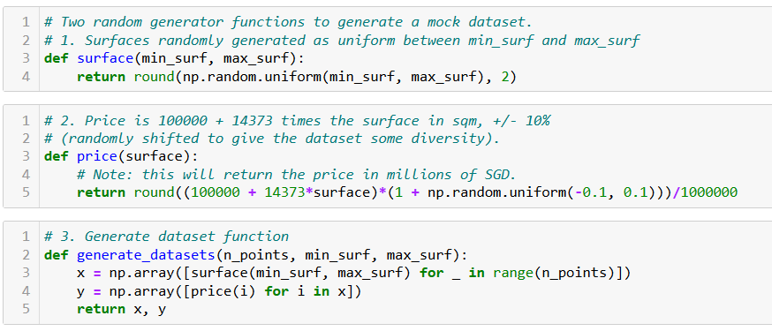
Our first toy example (mock dataset)

Slide 48
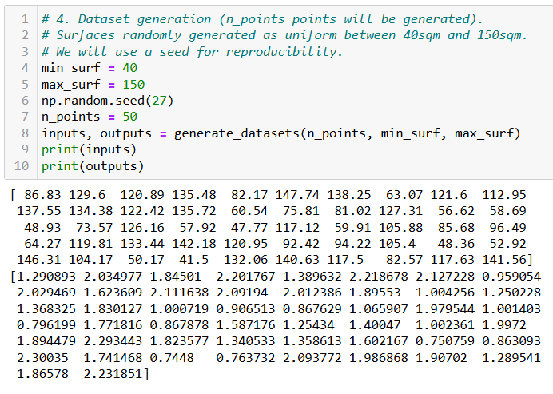
Our first toy example (mock dataset)

Slide 49
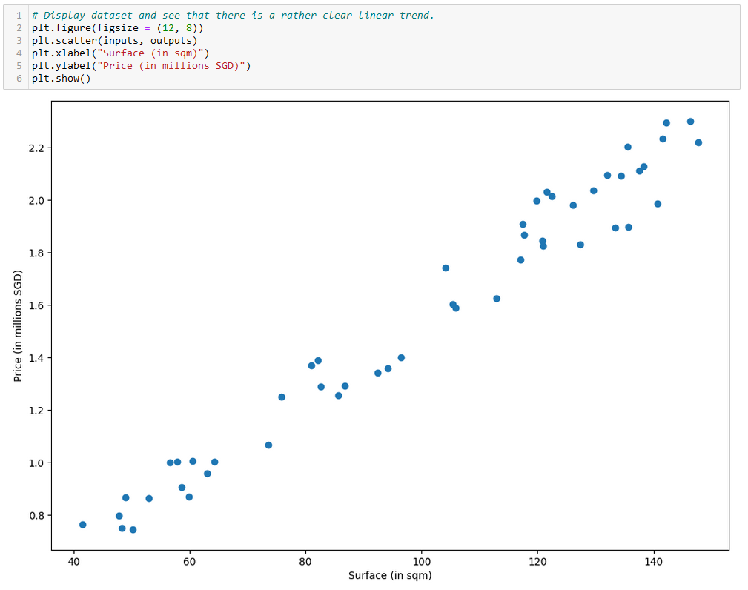

Slide 50
Our first toy example
Our first toy example: simplified version of the apartment price prediction.
Model (M) definition and its trainable parameters (P):
Here, our model will consist of a linear regression model.
By choosing such a model, we are making the assumption that the price of an apartment is a linear function of the surface of said apartment.

Slide 51
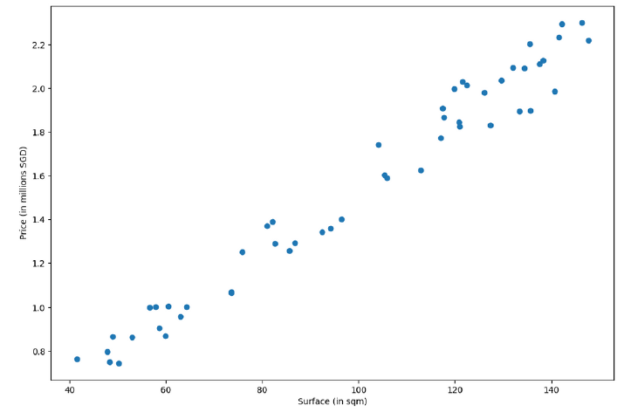
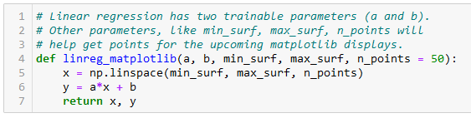
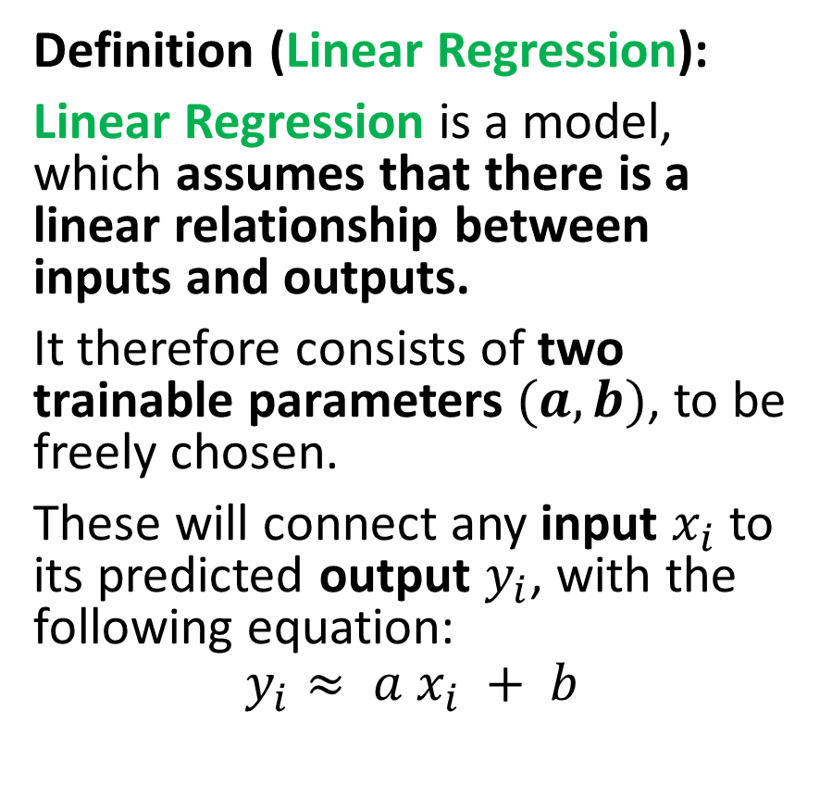
Our first model, the linear regression
Definition (Linear Regression):
Linear Regression is a model, which assumes that there is a linear relationship between inputs and outputs.
It therefore consists of two trainable parameters $(a, b)$, to be freely chosen.
These will connect any input $x_{i}$ to its predicted output $y_{i}$, with the following equation:
$$y_{i}≈ a x_{i} + b$$

Slide 52
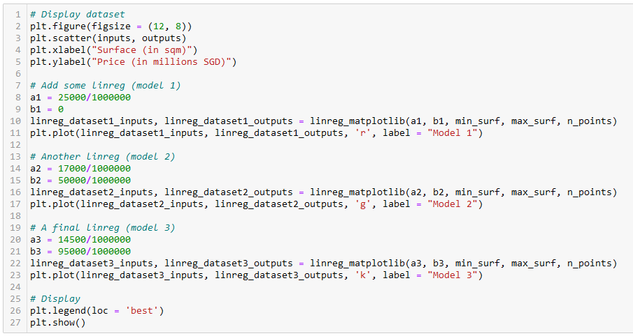
Let us try different values of (a, b)
Model 1 (red)
Model 2
(green)
Model 3
(black)

Slide 53
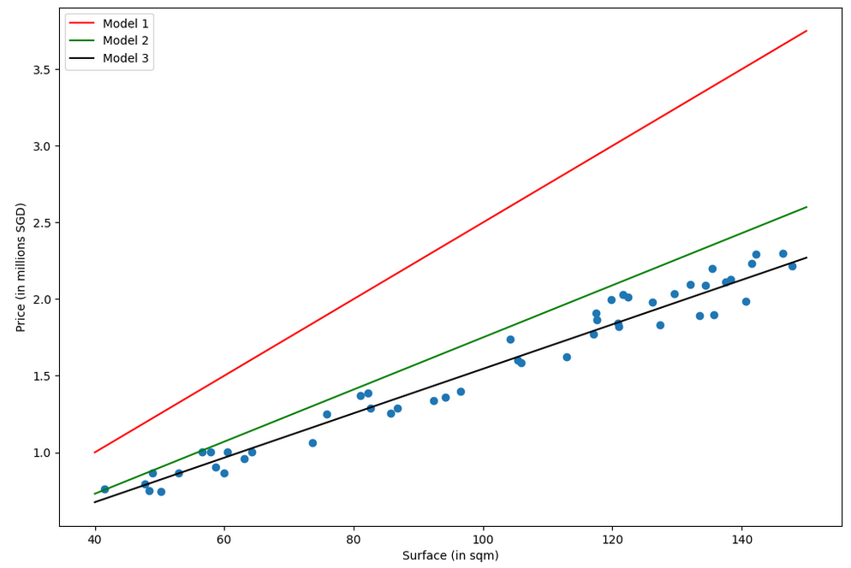
Which model is the best fit for this task in your opinion? (red, green or black?)
Why is one better than another?

Slide 54
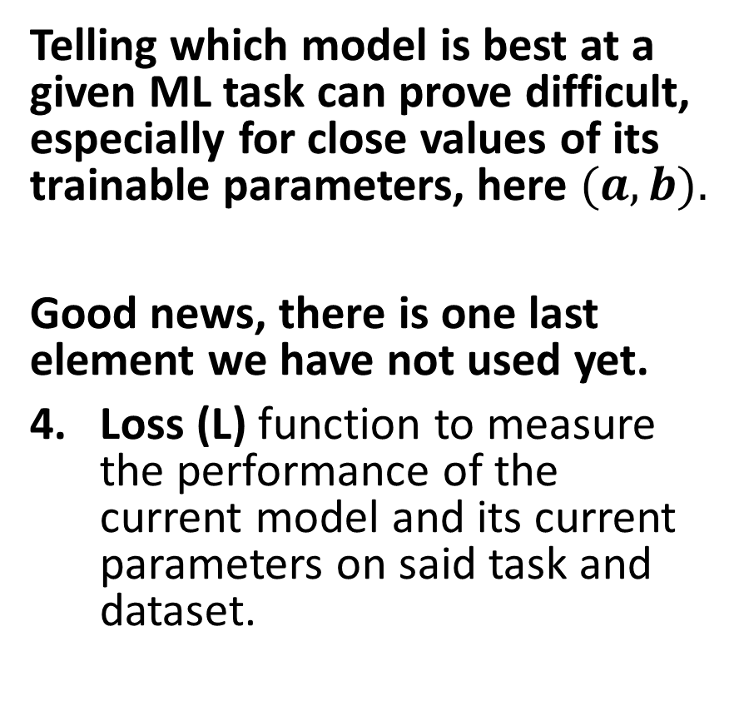
The need for a loss function
Which model is the best fit for this task in your opinion? (red, green or black?)
Why is one better than another?
Telling which model is best at a given ML task can prove difficult, especially for close values of its trainable parameters, here $(a, b).$
Good news, there is one last element we have not used yet.
Loss (L) function to measure the performance of the current model and its current parameters on said task and dataset.

Slide 55
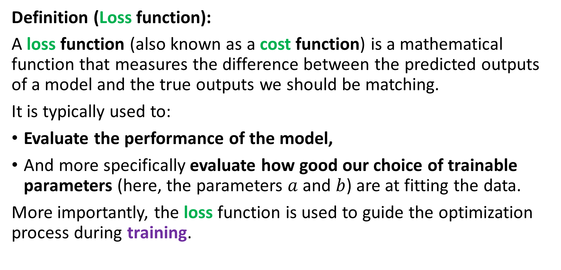
The need for a loss function
Definition (Loss function):
A loss function (also known as a cost function) is a mathematical function that measures the difference between the predicted outputs of a model and the true outputs we should be matching.
It is typically used to:
Evaluate the performance of the model,
And more specifically evaluate how good our choice of trainable parameters (here, the parameters $a$ and $b$) are at fitting the data.
More importantly, the loss function is used to guide the optimization process during training.

Slide 56
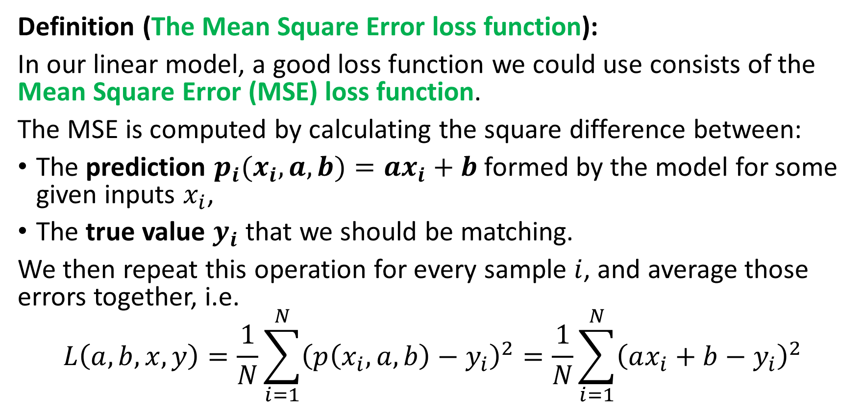
The need for a loss function
Definition (The Mean Square Error loss function):
In our linear model, a good loss function we could use consists of the Mean Square Error (MSE) loss function.
The MSE is computed by calculating the square difference between:
The prediction $p_{i}(x_{i},a,b)=ax_{i}+b$formed by the model for some given inputs $x_{i}$,
The true value $y_{i}$ that we should be matching.
We then repeat this operation for every sample $i$, and average those errors together, i.e.
$$L\left(a, b,x, y\right)=\frac{1}{N}\sum_{i=1}^{N}{{\left(p\left(x_{i}, a, b\right)−y_{i}\right)}^{2}}=\frac{1}{N}\sum_{i=1}^{N}{{\left(ax_{i}+b−y_{i}\right)}^{2}}$$

Slide 57
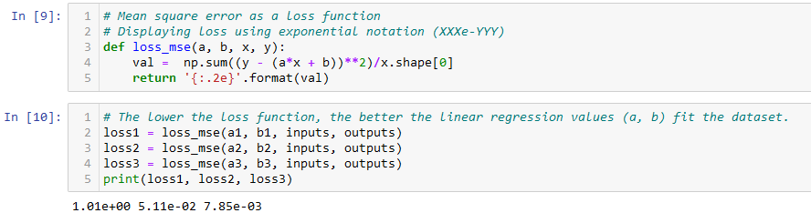

The need for a loss function
Recall the definition of the MSE loss function
$$L(a, b,x, y)=\frac{1}{N}\sum_{i=1}^{N}{{\left(ax_{i}+b−y_{i}\right)}^{2}}$$

Slide 58
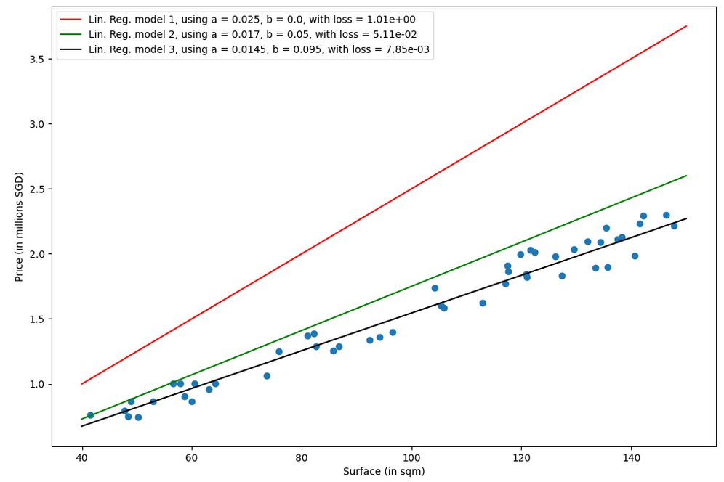
Which model is the best fit for this task in your opinion? (red, green or black?)
Why is one better than another?
Answer: Black model, because it has a lower loss value than the green and red ones!

Slide 59
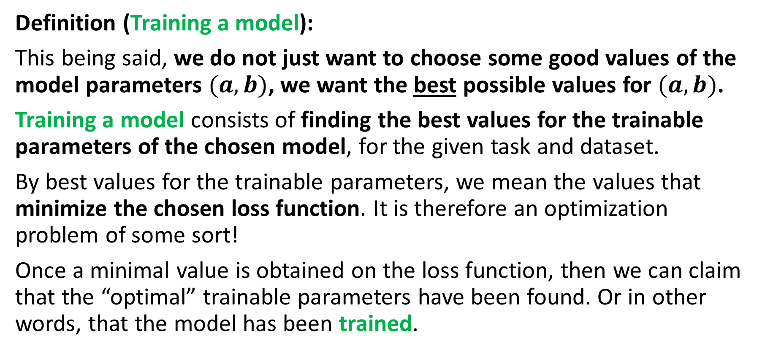
Training a model
Definition (Training a model):
This being said, we do not just want to choose some good values of the model parameters $(a, b)$, we want the best possible values for $(a, b)$.
Training a model consists of finding the best values for the trainable parameters of the chosen model, for the given task and dataset.
By best values for the trainable parameters, we mean the values that minimize the chosen loss function. It is therefore an optimization problem of some sort!
Once a minimal value is obtained on the loss function, then we can claim that the “optimal” trainable parameters have been found. Or in other words, that the model has been trained.

Slide 60
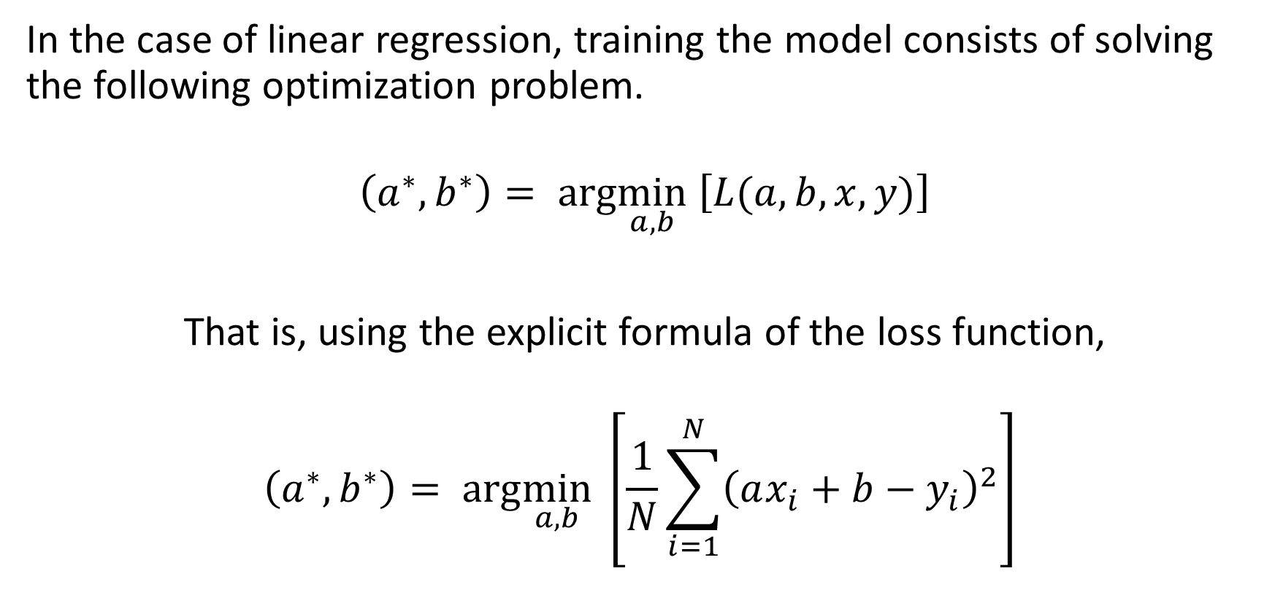
Training a linear regression model
In the case of linear regression, training the model consists of solving the following optimization problem.
$$\left(a^{∗},b^{∗}\right)= arg\min_{a,b} \left[L(a, b,x, y)\right]$$
That is, using the explicit formula of the loss function,
$$\left(a^{∗},b^{∗}\right)= arg\min_{a,b} \left[\frac{1}{N}\sum_{i=1}^{N}{{\left(ax_{i}+b−y_{i}\right)}^{2}}\right]$$

Slide 61
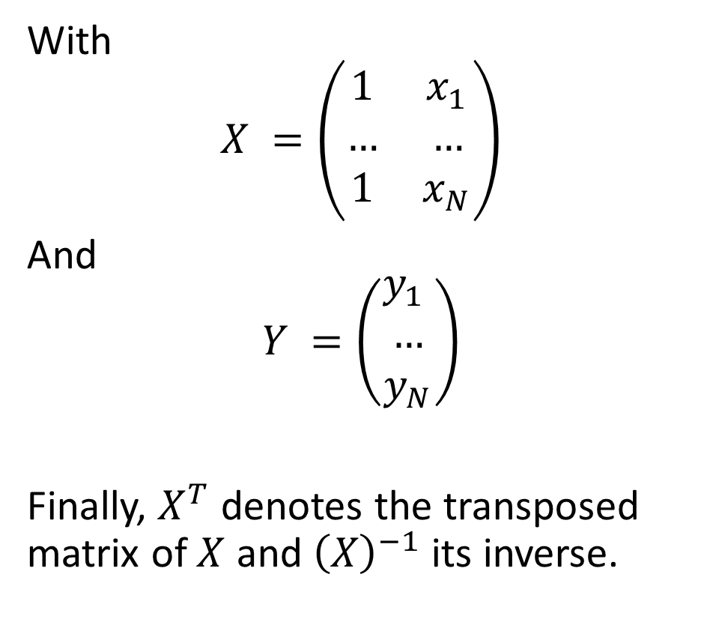
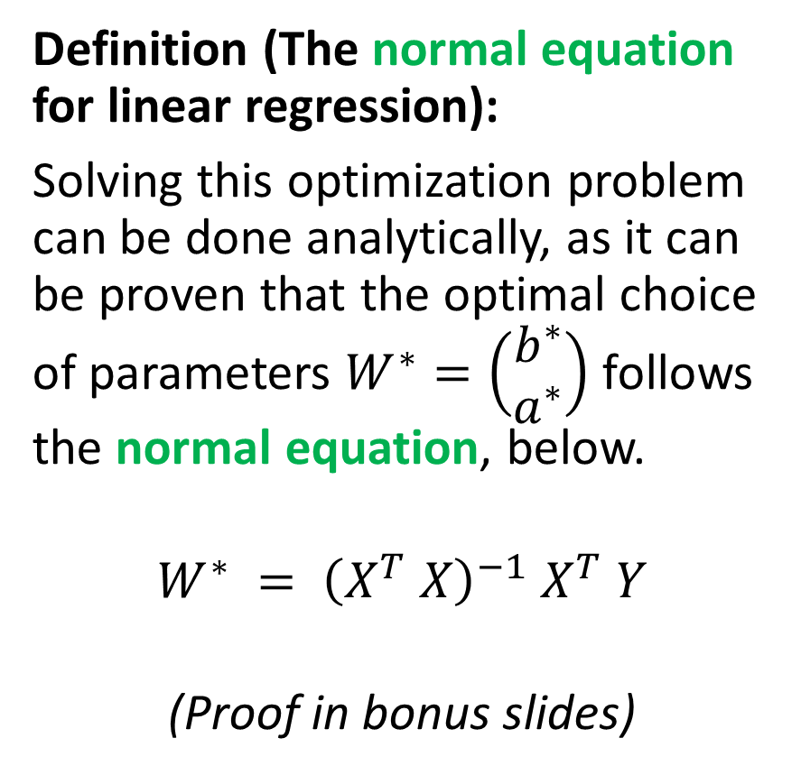
Training a linear regression model
Definition (The normal equation for linear regression):
Solving this optimization problem can be done analytically, as it can be proven that the optimal choice of parameters $W^{∗}=\left(\begin{matrix}b^{∗} \\ a^{∗}\end{matrix}\right)$ follows the normal equation, below.
$$W^{∗} = {\left(X^{T} X\right)}^{−1} X^{T} Y$$
(Proof in bonus slides)
With
$$X =\left(\begin{matrix}1 & x_{1} \\ … & … \\ 1 & x_{N}\end{matrix}\right)$$
And
$$Y =\left(\begin{matrix}y_{1} \\ … \\ y_{N}\end{matrix}\right)$$
Finally, $X^{T}$ denotes the transposed matrix of $X$ and ${\left(X\right)}^{−1}$its inverse.

Slide 62
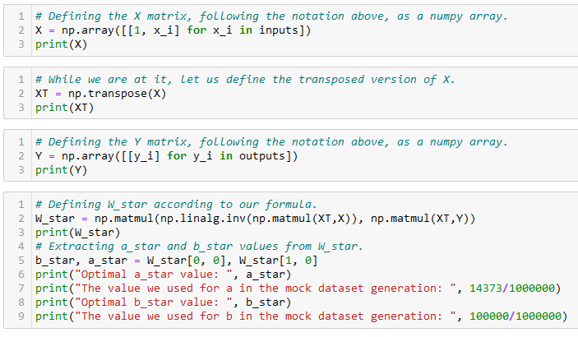

Training a linear regression model
Normal Equation: $W^{∗} = {\left(X^{T} X\right)}^{−1} X^{T} Y$

Slide 63
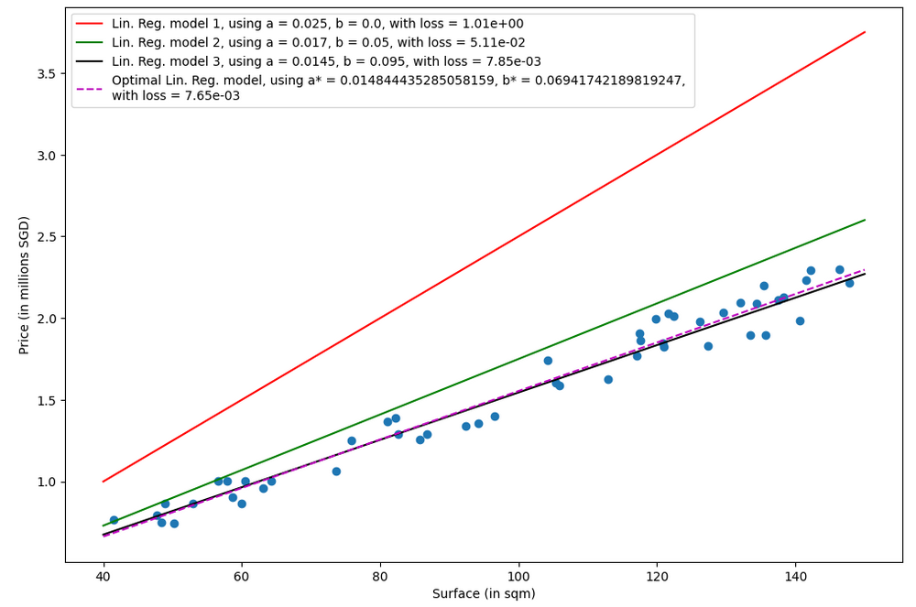
Purple line is the optimal set of parameters for our model on the given task and dataset!
Black was pretty close!

Slide 64
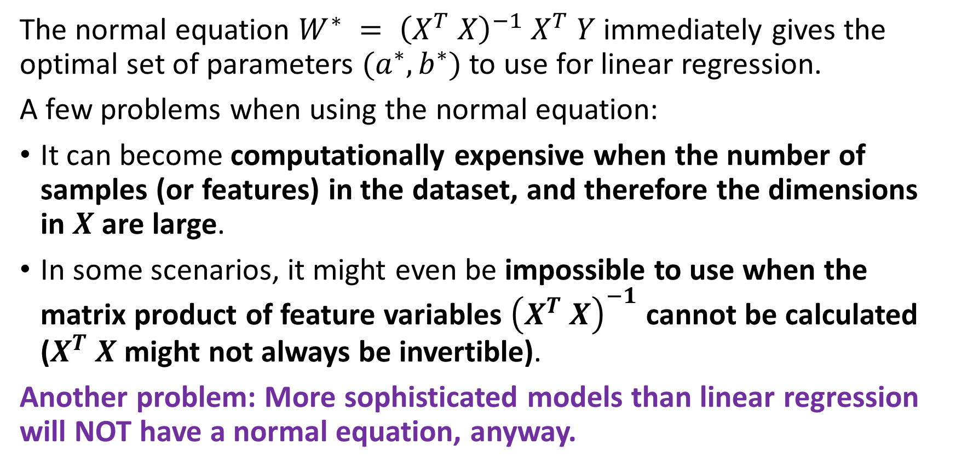
The problem with the normal equation
The normal equation $W^{∗} = {\left(X^{T} X\right)}^{−1} X^{T} Y$immediately gives the optimal set of parameters $(a^{∗}, b^{∗})$to use for linear regression.
A few problems when using the normal equation:
It can become computationally expensive when the number of samples (or features) in the dataset, and therefore the dimensions in $X$ are large.
In some scenarios, it might even be impossible to use when the matrix product of feature variables ${\left(X^{T} X\right)}^{−1}$ cannot be calculated ($X^{T} X$might not always be invertible).
Another problem: More sophisticated models than linear regression will NOT have a normal equation, anyway.

Slide 65
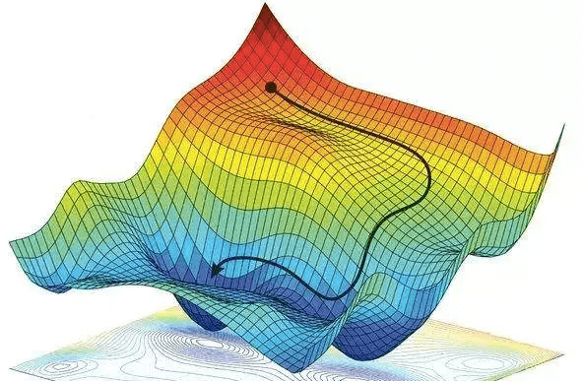
Gradient Descent, to the rescue!
Definition (Gradient Descent):
Gradient Descent (GD) is an iterative algorithm used to solve optimization problems.
It starts with an initial non-optimal set of parameters for our model.
It then repeatedly updates the parameters in the direction of the negative gradient of the given loss/cost function, until it converges to a local minimum.
Forgot about GD? Have a look at your notes from 10.013 M&A!

Slide 66
Gradient Descent, to the rescue!
Definition (Gradient Descent):
Gradient Descent (GD) is an iterative algorithm used to solve optimization problems.
It starts with an initial non-optimal set of parameters for our model.
It then repeatedly updates the parameters in the direction of the negative gradient of the given loss/cost function, until it converges to a local minimum.
The normal equation has many problems…
But GD, on the other hand can be used to find the optimal solution even when the normal equation is not applicable.
While sub-optimal, the main advantage of gradient descent is that it can handle very large datasets and it can also be used for non-linear models.

Slide 67

GD in Linear Regression
In the case of Linear Regression, with the MSE loss defined earlier, we have
$$\left(a^{∗},b^{∗}\right)= arg\min_{a,b} \left[L(a, b,x, y)=\frac{1}{N}\sum_{i=1}^{N}{{\left(ax_{i}+b−y_{i}\right)}^{2}}\right]$$

Slide 68
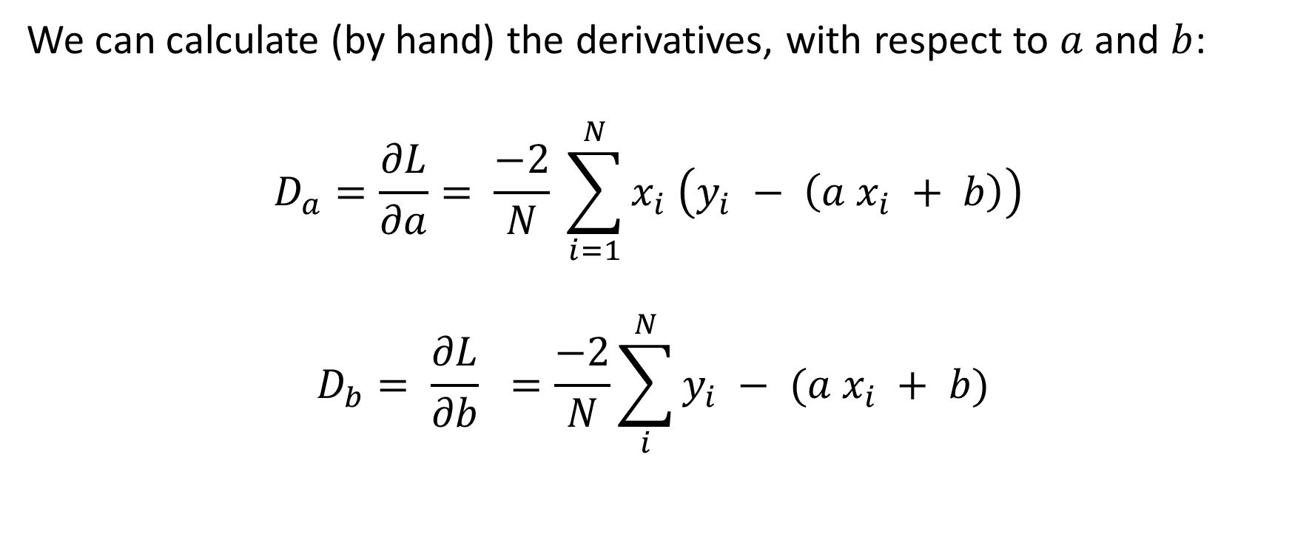
GD in Linear Regression
We can calculate (by hand) the derivatives, with respect to $a$ and $b$:
$$D_{a}=\frac{∂L}{∂a}= \frac{−2}{N} \sum_{i=1}^{N}{x_{i} \left(y_{i} − \left(a x_{i} + b\right)\right)}$$
$$D_{b}= \frac{∂L}{∂b} =\frac{−2}{N}\sum_{i}^{N}{y_{i} − (a x_{i} + b)}$$

Slide 69
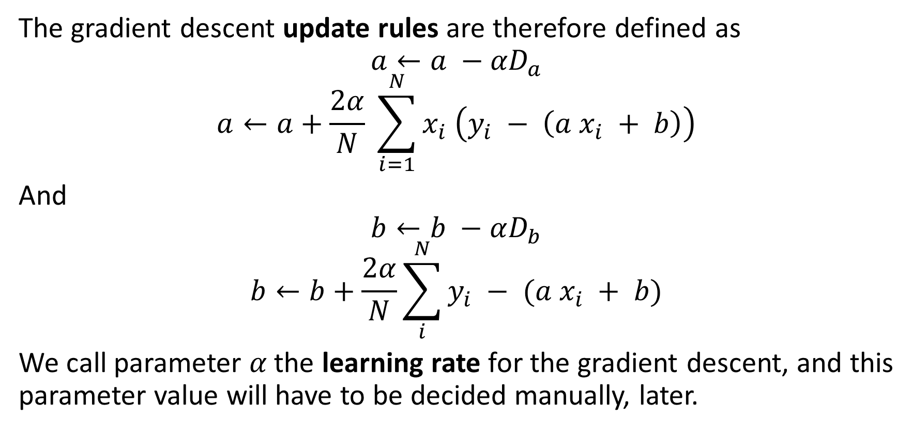
GD in Linear Regression
The gradient descent update rules are therefore defined as
$$a←a −{αD}_{a}$$
$$a←a+\frac{2α}{N} \sum_{i=1}^{N}{x_{i} \left(y_{i} − \left(a x_{i} + b\right)\right)}$$
And
$$b←b −αD_{b}$$
$$b←b+\frac{2α}{N}\sum_{i}^{N}{y_{i} − (a x_{i} + b)}$$
We call parameter 𝛼 the learning rate for the gradient descent, and this parameter value will have to be decided manually, later.

Slide 70
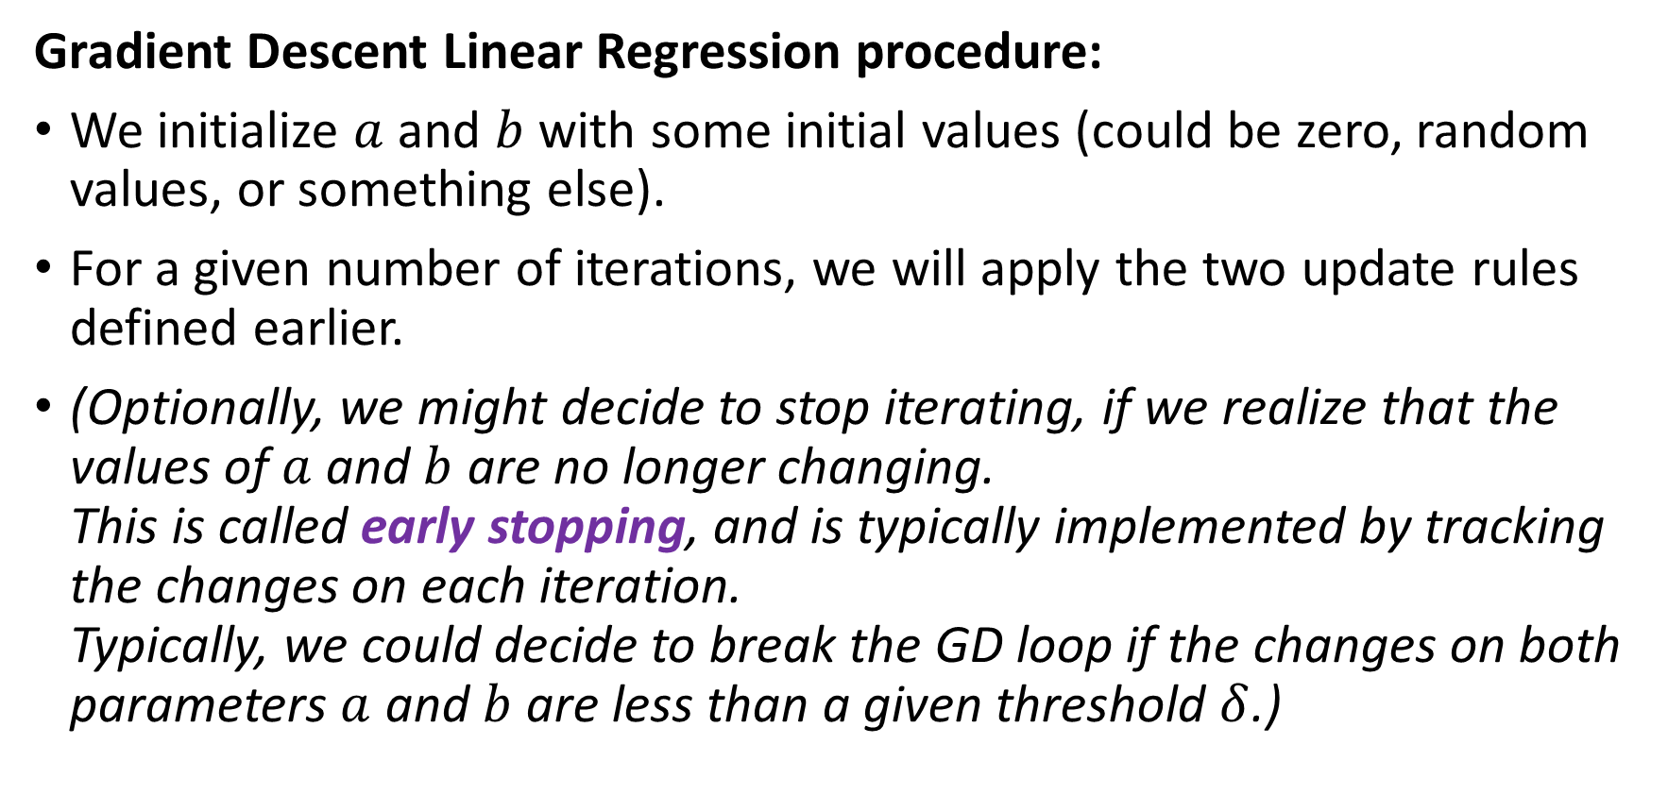
GD in Linear Regression
Gradient Descent Linear Regression procedure:
We initialize $a$ and $b$ with some initial values (could be zero, random values, or something else).
For a given number of iterations, we will apply the two update rules defined earlier.
(Optionally, we might decide to stop iterating, if we realize that the values of $a$ and $b$ are no longer changing. This is called early stopping, and is typically implemented by tracking the changes on each iteration. Typically, we could decide to break the GD loop if the changes on both parameters $a$ and $b$ are less than a given threshold $δ$.)

Slide 71
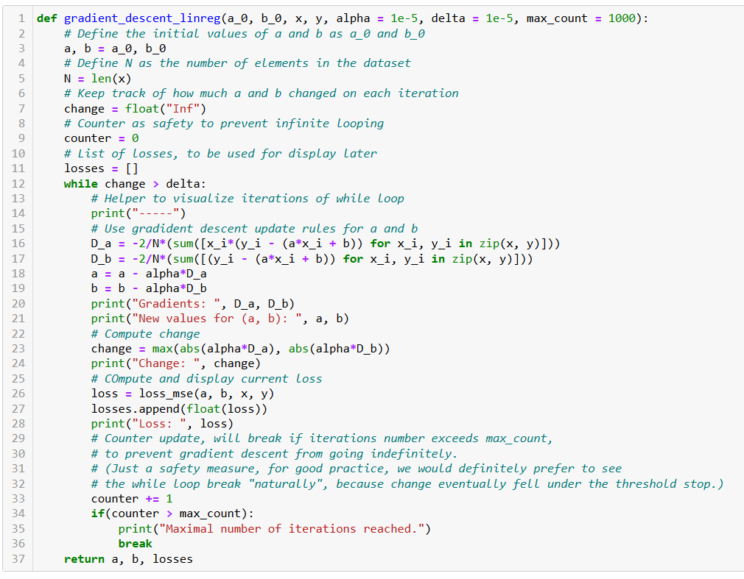
Initialize a and b as you please.

Slide 72
Number of samples in dataset.

Slide 73
Two possible stopping conditions, change < delta or counter > max_count.

Slide 74
Update using our GD update rules from earlier.

Slide 75
Compute change on this iteration (to decide on early stopping if changes become insignificant).

Slide 76
Calculate new MSE value using the new parameters of a and b. We also keep track of these loss values by adding them to a list, used for display later.

Slide 77
Return trained parameters and loss values list on each iteration.

Slide 78
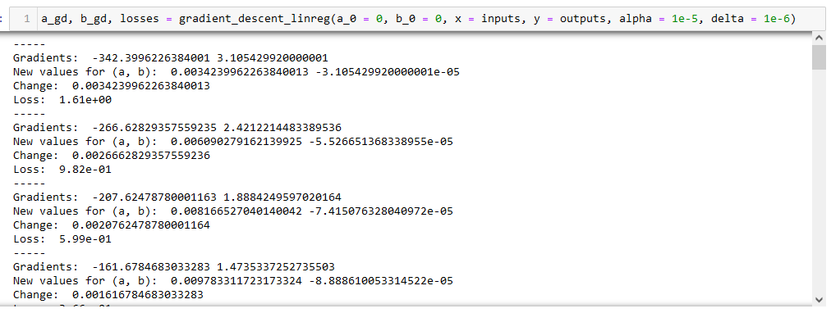
Observation: Loss is decreasing over iterations (which is good news for us!)

Slide 79
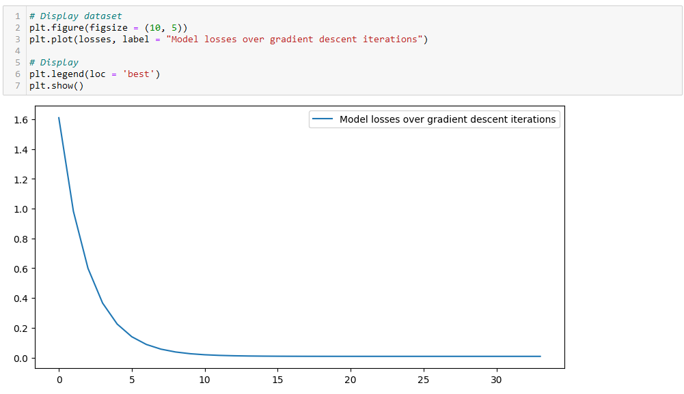
Observation: Confirmed with a plot. Loss is decreasing over iterations (which is good news for us!)
Even seems to converge to a minimum value, corresponding to the optimal set of trainable parameters?

Slide 80
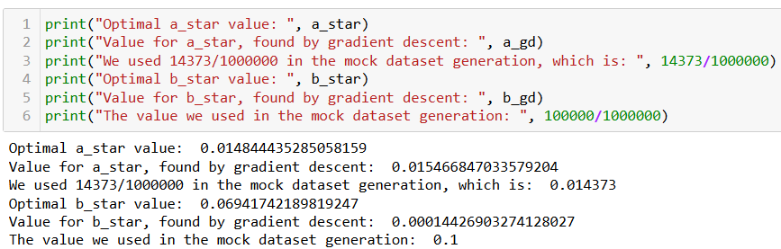

Checking for optimal parameters
We have generated the dataset ourselves, so we know the optimal values for $a$ and $b$! (And we can even compute using the normal equation anyway…)

Slide 81
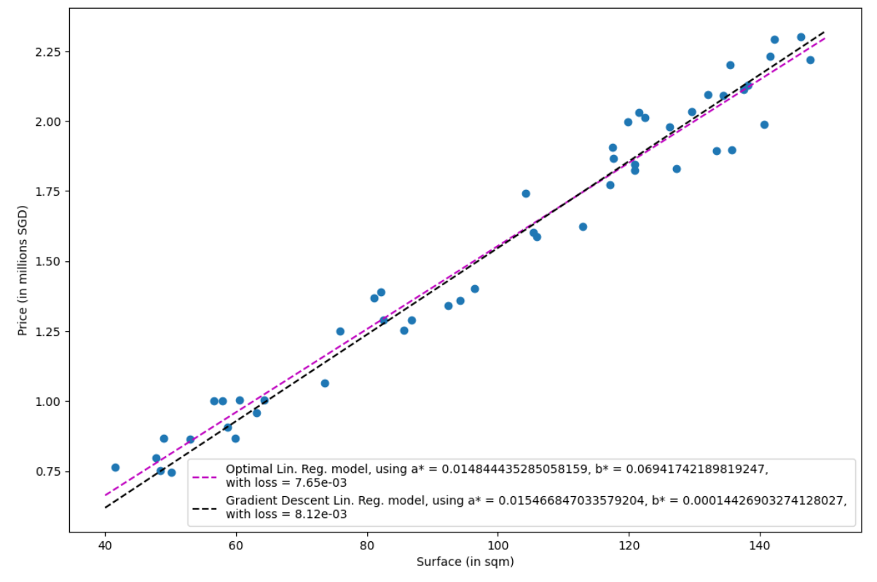
Observation: Close match, good enough for us. (Maybe could get better with more iterations of GD?)

Slide 82
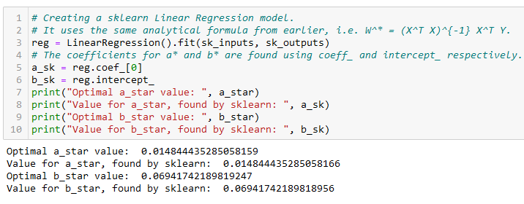
Using Sklearn for Linear regression
In practice, we never implement the linear regression model ourselves (but like many other things in CS, it is a good practice to try it once!)
It is often better/faster to rely on the sklearn library and use the LinearRegression object!

Slide 83
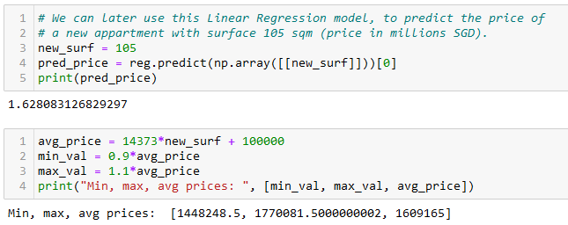
Predicting using Linear Regression
After training, it is also good practice to check if the predictor makes sense, by testing it and asking it to predict the price of an apartment it has never seen before.
Confirm the pertinence of predicted values manually, if possible.

Slide 84
Let us call it a break for today
We will continue on the next lecture with more reminders (Bonus slides after this)

Slide 85
More specifically
Specific topics in linear algebra to focus on:
Vectors, dot product, norms of vectors
Matrices and their properties: determinant, rank, norm, trace, transpose
Matrix multiplication and inversion
Solving systems of linear equations
Eigenvectors and eigenvalues
Projections and orthonormality
(Symmetric matrices, positive semi-definite matrices)
(Matrix decompositions, e.g. LU decomposition, SVD)

Slide 86
More specifically
Specific topics in calculus to focus on:
Logarithmic and exponential functions
Derivatives and partial derivatives, the chain rule of derivatives
(Integrals basics)
Multivariate calculus: functions of vectors and matrices and their gradients.
(Jacobian and Hessian)
Equations of lines and hyperplanes
Solving optimization problems with Gradient Descent, Lagrange multipliers, and other methods.

Slide 87
More specifically
Specific topics in probabilities and statistics to focus on:
Probability rules and axioms, random variables (both discrete and continuous)
Standard distributions (Bernoulli, Binomial, Multinomial, Uniform and Gaussian)
Expectation, variance, covariance and correlation
Conditional probability, Bayes’ theorem
(Law of total probability)
(Joint and marginal probability distributions)
The central limit theorem

Slide 88
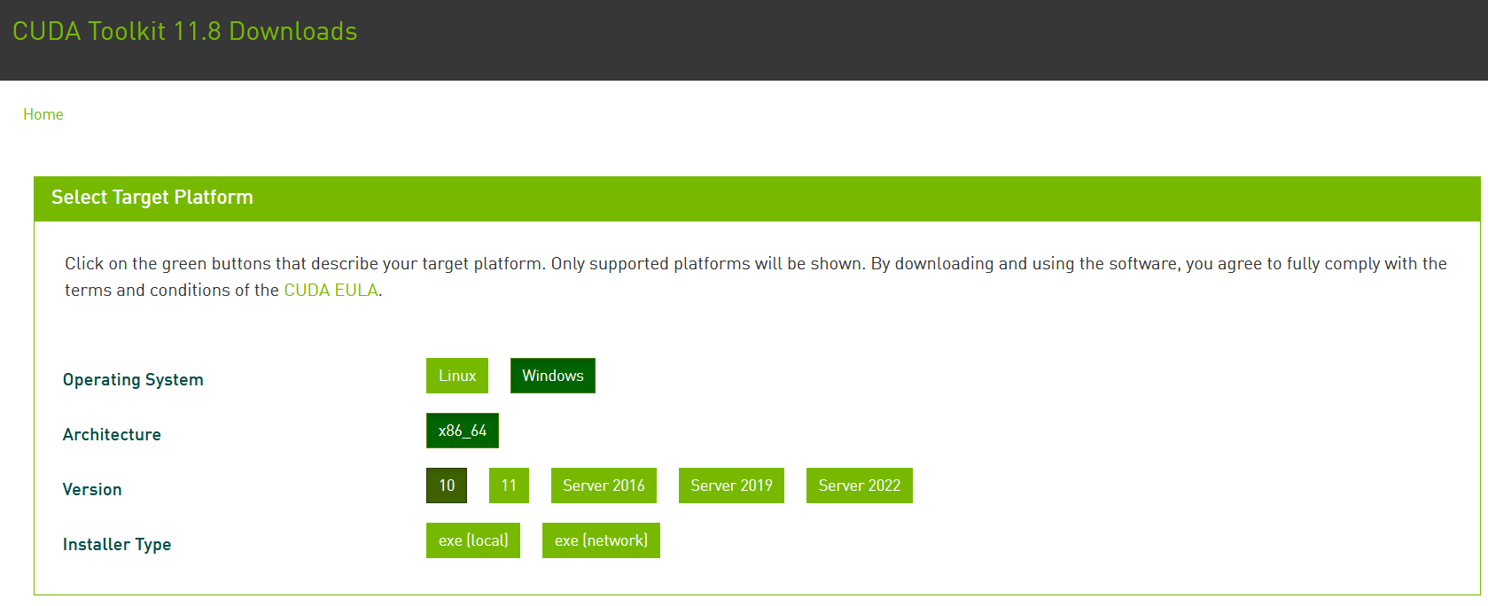
Installing PyTorch and CUDA
Check if your GPU is in the list of acceptable GPUs. https://developer.nvidia.com/cuda-gpus
If so, install CUDA (check that you CUDA version number matches the one of your PyTorch install!) https://developer.nvidia.com/cuda-downloads

Slide 89
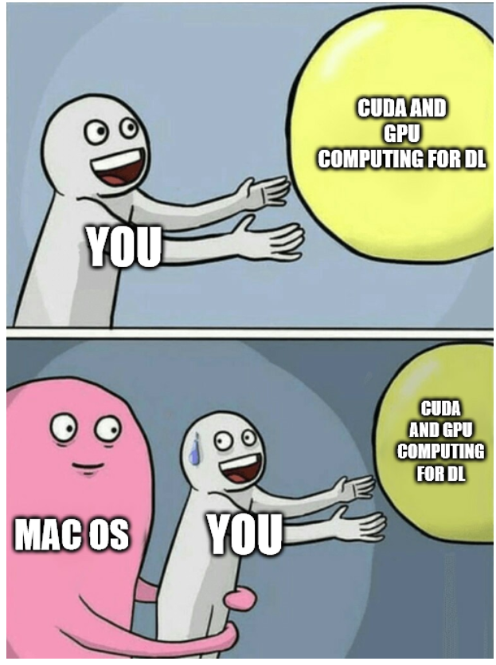
Installing PyTorch and CUDA
Question: How to use CUDA with MacOS?
Efforts are being made to make GPU computing compatible with AMD and MacOS GPUs, but not the best (afaik).

Slide 90


Installing PyTorch and CUDA
Your GPU not in the list of CUDA-enabled GPUs?
You bought a MacOS laptop?
All notebooks can run on CPU (but they might take significantly longer to run).
Also, always the option of using Google Colab, or create an education account on AWS.

Slide 91



Checking your PyTorch and CUDA install
Hello World for PyTorch: to check you have PyTorch installed correctly. The code below should run and display a tensor.
Hello World for CUDA: to check you have correctly installed CUDA on top of PyTorch. The code below should print True, as the output of torch.cuda.is_available()

Slide 92

A quick word about PyTorch 2.0
PyTorch v2.0 is the current (latest version released in March 2023).
Should be fully retro-compatible.
Revising and testing notebooks (they were designed last year and tested on v1.13).
Kindly let me know if you have any issues!
Will let you know about new v2.0 features on W13.

Slide 93
Supervised vs Unsupervised Learning
Definition (Supervised vs. Unsupervised Learning):
Supervised and Unsupervised Learning are the two techniques of ML.
The main difference is the need for labelled training data:
Supervised machine learning relies on labelled input and output data to learn and make predictions,
while unsupervised learning does not require labelled data.

Slide 94

Unsupervised Learning Examples
Examples of unsupervised learning: clustering customers based on their behaviours, segmenting images, and identifying topics in a document.

Slide 95


Unsupervised Learning Examples
Identify topics that seem to appear in those papers and their prominence
Examples of unsupervised learning: clustering customers based on their behaviours, segmenting images, and identifying topics in a document.

Slide 96
Clustering vs. Association (Unsupervised)
Definition (Clustering vs. Association):
Unsupervised learning can be used for two types of problems: Clustering and Association.
The main difference is that
clustering groups data based on similarity,
while association looks for relationships between variables.

Slide 97
Clustering vs. Association (Unsupervised)
Examples of clustering:
Group customers into clusters based on the similarities in their purchasing behaviours, such as their spending habits or types of products they like.
Group the catalogue of movies available on Netflix and identify what movies have in common, so you can later recommend a movie to a user based on what he/she has seen before.

Slide 98




Clustering vs. Association (Unsupervised)
Example of association:
Finding the relationship between customer buying behaviors and customer satisfaction.
Association can be used to understand how changes in customer behavior impacts customer satisfaction, such as if buying a certain product increases customer satisfaction (or the opposite).

Slide 99


Proof of the Normal Equation
Using the notations
$$X =\left(\begin{matrix}1 & x_{1} \\ … & … \\ 1 & x_{N}\end{matrix}\right),$$
$$Y =\left(\begin{matrix}y_{1} \\ … \\ y_{N}\end{matrix}\right),$$
$$W^{∗}=\left(\begin{matrix}b^{∗} \\ a^{∗}\end{matrix}\right)$$
We have, in matrix form
$$XW^{∗}=\left(\begin{matrix}a^{∗}x_{1}+b^{∗} \\ … \\ a^{∗}x_{N}+b^{∗}\end{matrix}\right)$$
And, then it follows that
$$XW^{∗}−Y=\left(\begin{matrix}a^{∗}x_{1}+b^{∗} −y_{1} \\ … \\ a^{∗}x_{N}+b^{∗}−y_{N}\end{matrix}\right)$$

Slide 100

Proof of the Normal Equation
Our loss function, the MSE $L$, is therefore defined, in matrix format as:
$$L=\frac{1}{N}{\left(XW^{∗}−Y\right)}^{T}\left(XW^{∗}−Y\right)$$
This is equivalent to
$$L=\frac{1}{N}\left({\left(XW^{∗}\right)}^{T}−Y^{T}\right)\left(XW^{∗}−Y\right)$$

Slide 101

Proof of the Normal Equation
We then get
$$L=\frac{1}{N}\left({W^{∗}}^{T}X^{T}−Y^{T}\right)\left(XW^{∗}−Y\right)$$
Expanding
$$L=\frac{1}{N}({W^{∗}}^{T}X^{T}XW^{∗}−Y^{T}XW^{∗}− {W^{∗}}^{T}X^{T}Y+Y^{T}Y)$$

Slide 102

Proof of the Normal Equation
Recall that we are trying to find the solution to optimization problem
$$\left(a^{∗},b^{∗}\right)=arg\min_{a,b}\left[L(a, b,x, y)\right]$$
With
$$L=\frac{1}{N}({W^{∗}}^{T}X^{T}XW^{∗}−Y^{T}XW^{∗}−{W^{∗}}^{T}X^{T}Y+Y^{T}Y)$$
Recognizing that $Y^{T}XW^{∗}={W^{∗}}^{T}X^{T}Y$, differentiating our function $L$with respect to $W$ and equating it to zero gives:
$$\frac{∂L}{∂W}=\frac{1}{N}\left({2X}^{T}XW−2X^{T}Y\right)=0$$

Slide 103

Proof of the Normal Equation
This is equivalent to
$$\left(X^{T}XW^{∗}−X^{T}Y\right)=0$$
Or,
$$X^{T}XW^{∗}=X^{T}Y$$
Assuming $X^{T}X$ is invertible (and that might not always be the case based on your dataset!), this finally gives:
$$W^{∗}={\left(X^{T}X\right)}^{−1}X^{T}Y$$

